Slide 1
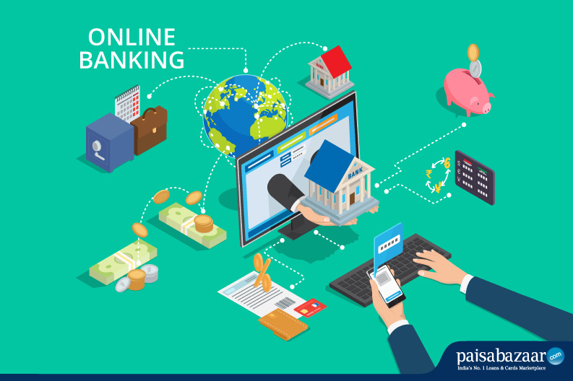
BHARAT BANK
Done by – N. Manasi
Kishan Kumar M N
Suresh S Gowd
Nalini Pogula
M Mahesh
M Manjunath
Deepak Vaswani
Satyajit Chandra
Sireesha Nemalidinne

Slide 2

What Is Online Banking? Online banking allows a user to conduct financial transactions via the Internet. Online banking is also known as Internet banking or web banking. Online banking offers customers almost every service traditionally available through a local branch including deposits, transfers, and online bill payments. Virtually every banking institution has some form of online banking, available in desktop versions.

Slide 3
Advantages of Online Banking
Convenience is a major advantage of online banking. Basic banking transactions such as paying bills and transferring funds between accounts can easily be done 24 hours a day, seven days a week, wherever a consumer wishes.
Online banking is fast and efficient. Funds can be transferred between accounts almost instantly, especially if the two accounts are held at the same institution. Consumers can open and close a number of different accounts online, from fixed deposits to recurring deposit accounts that typically offer higher rates of interest.
Consumers can also monitor their accounts regularly closely, allowing them to keep their accounts safe. Around-the-clock access to banking information provides early detection of fraudulent activity, thereby acting as a guardrail against financial damage or loss.

Slide 4
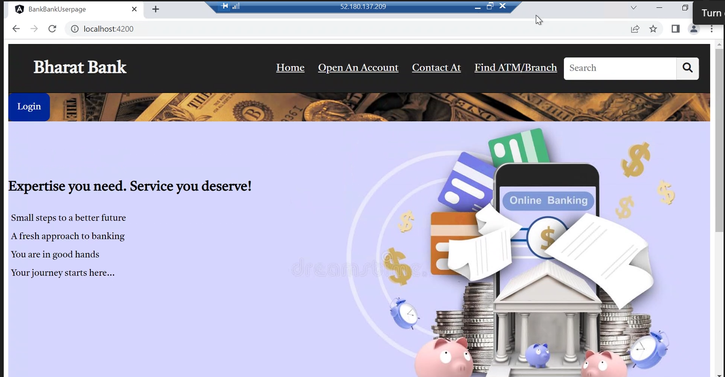
Home Page

Slide 5
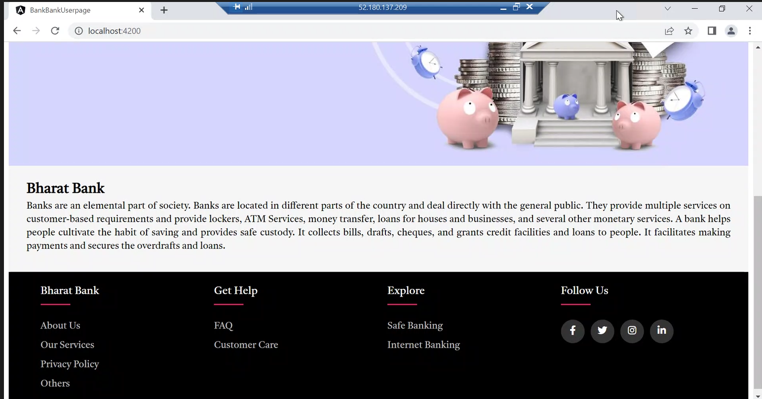
Home Page -2

Slide 6
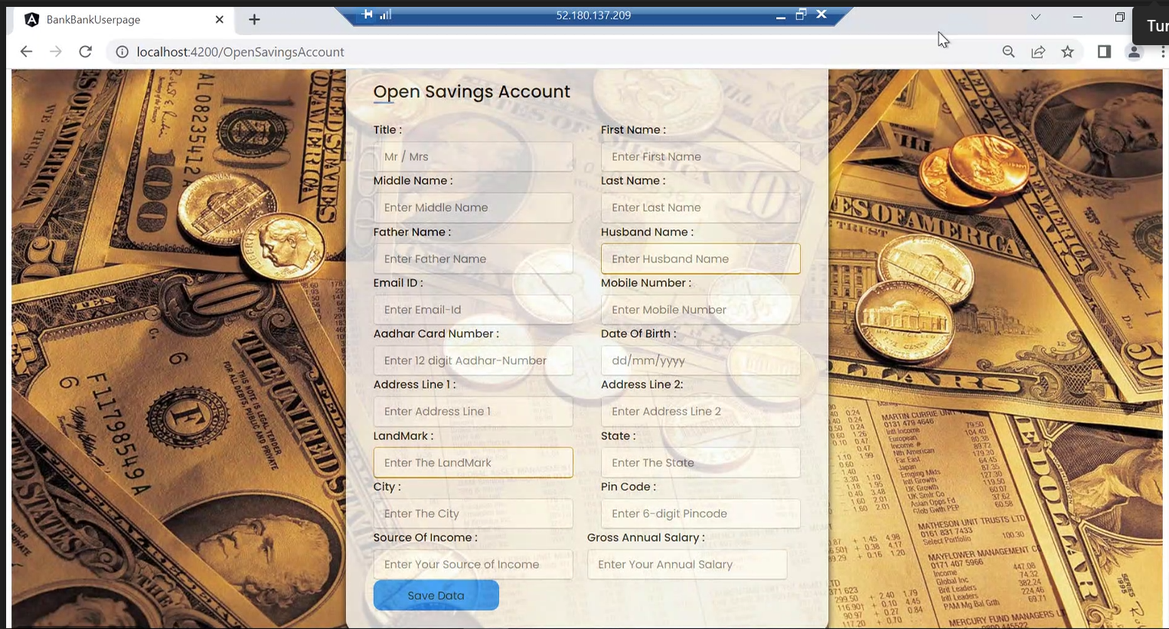
Open Savings Account

Slide 7
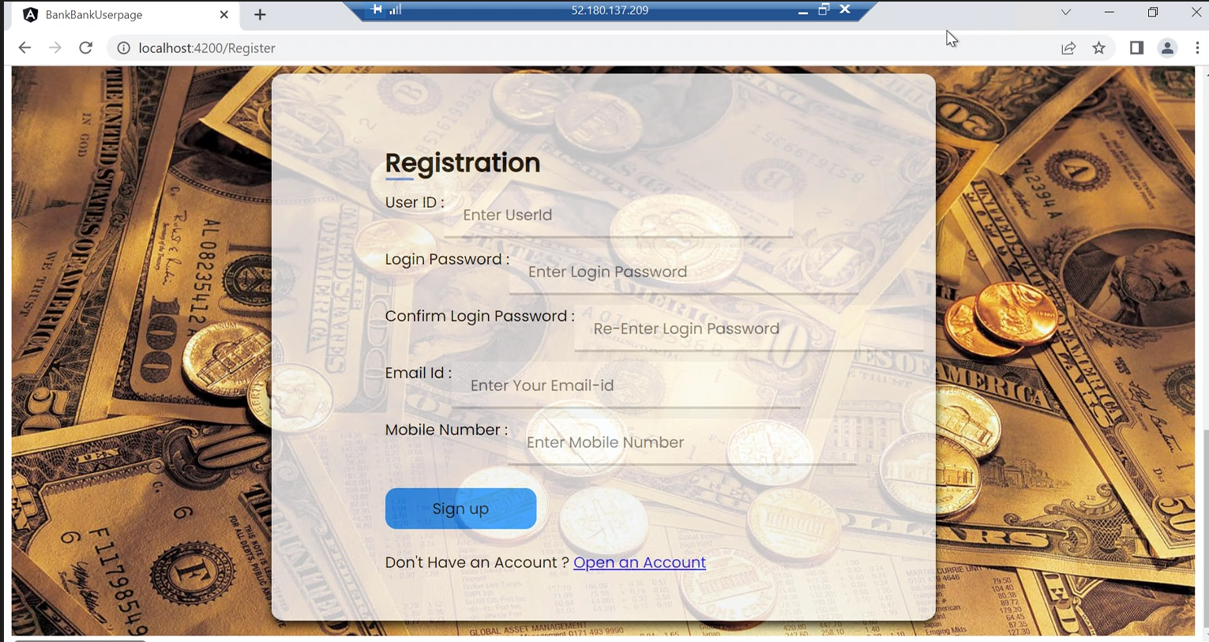
Registration

Slide 8
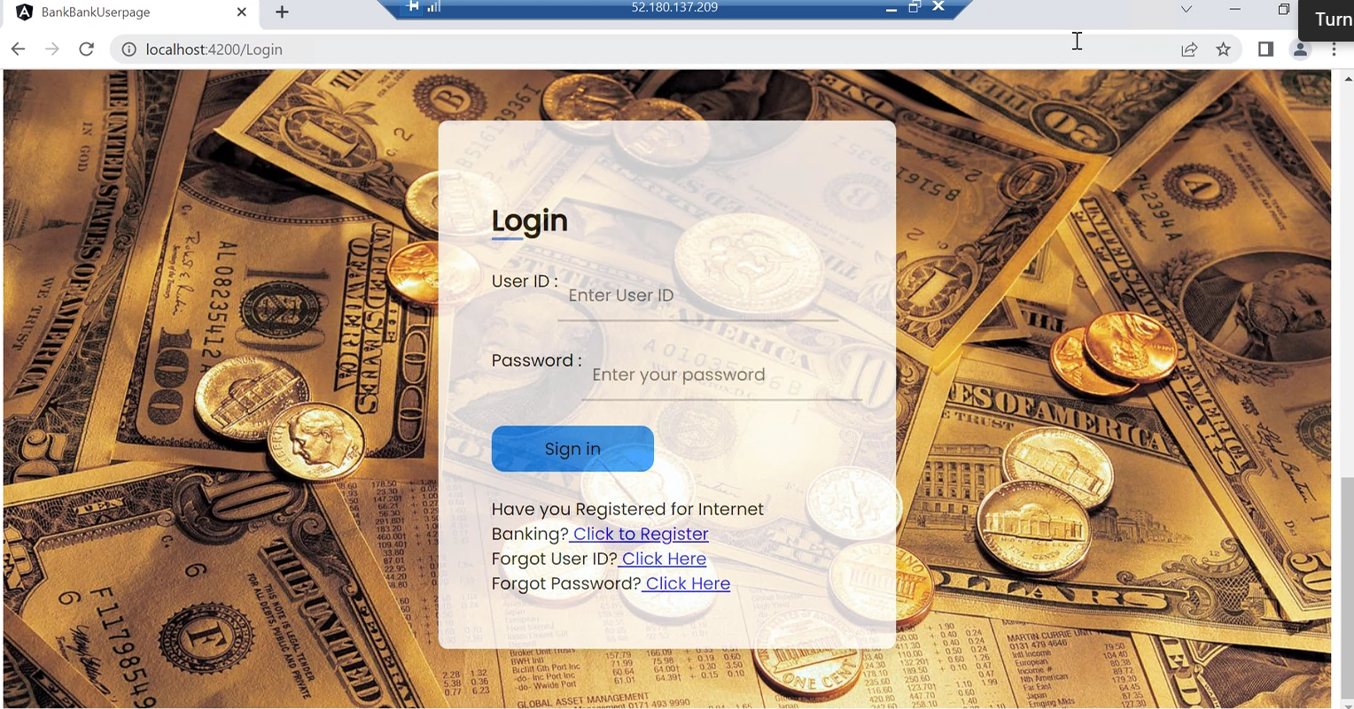
Login

Slide 9
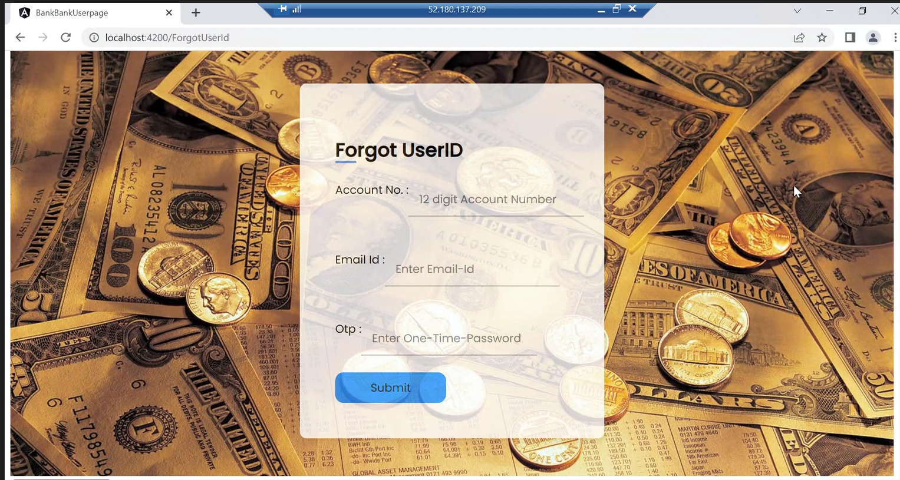
Forgot User ID

Slide 10
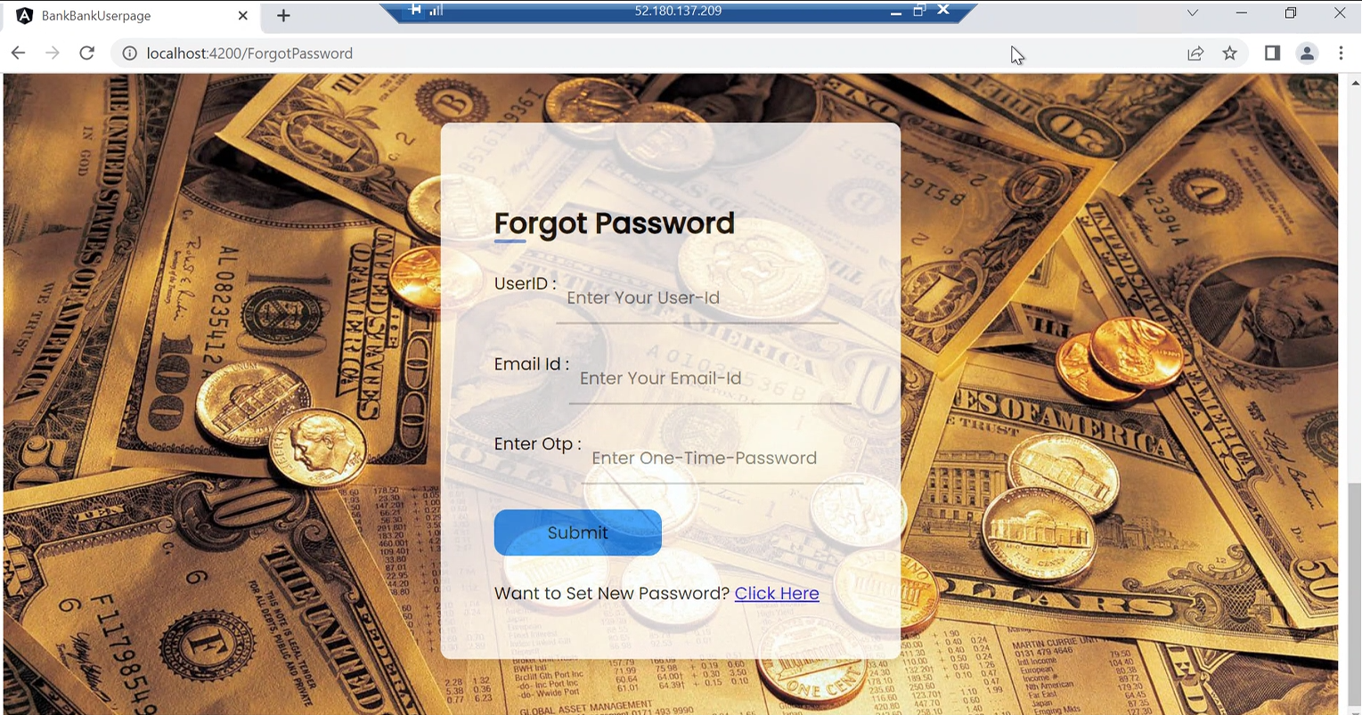
Forgot Password

Slide 11
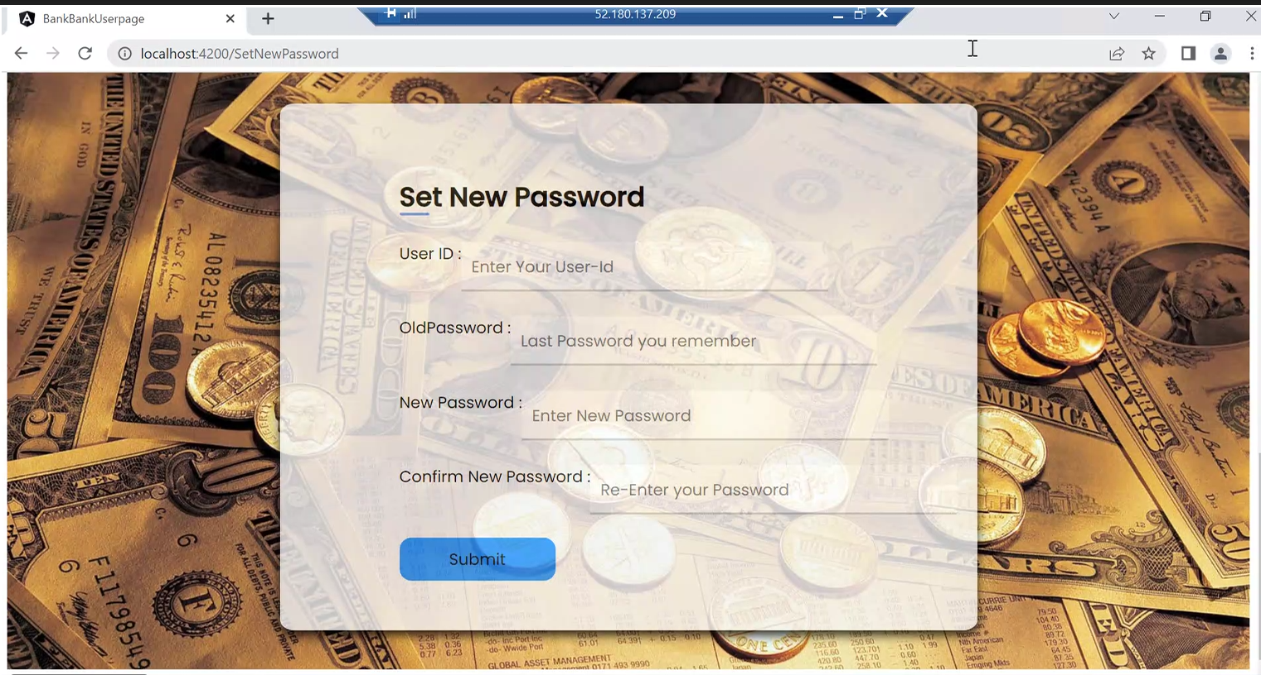
Set New Password

Slide 12
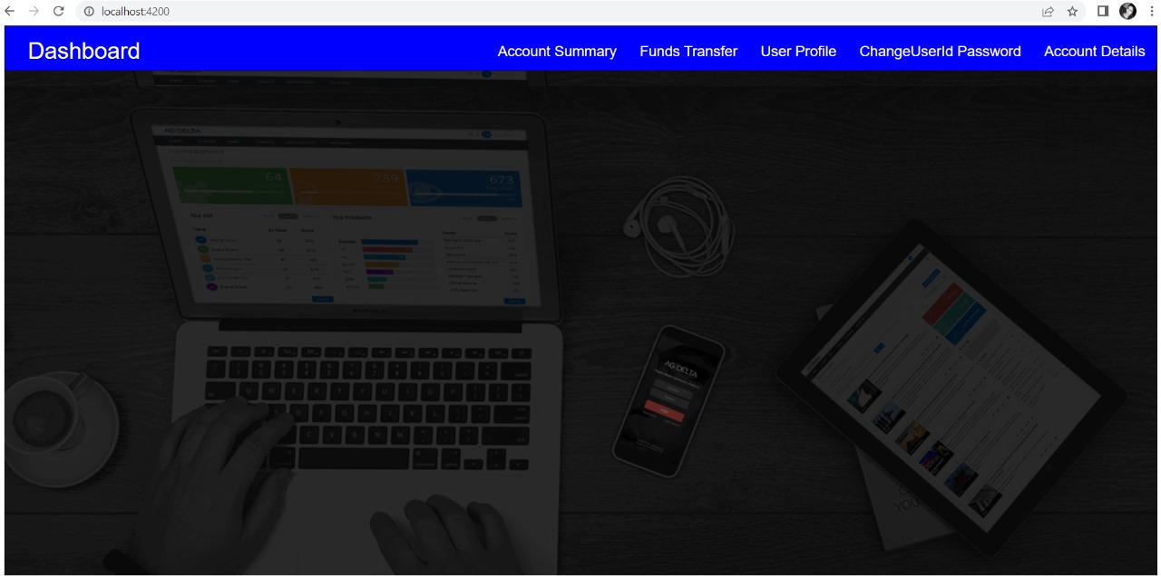
Dashboard

Slide 13
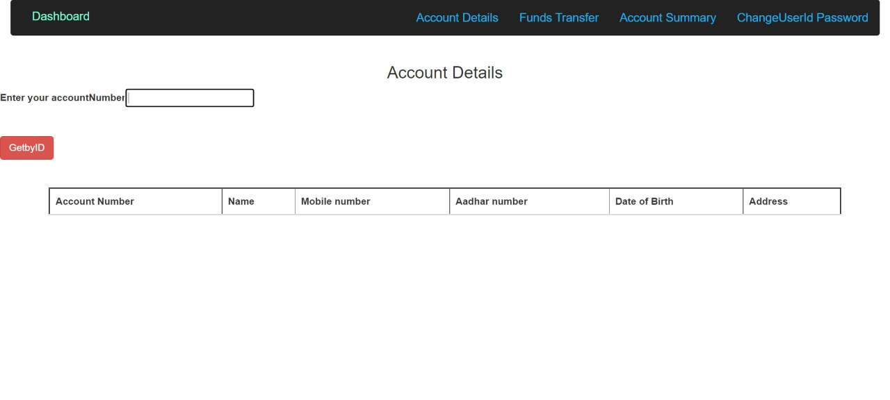
Account Details Layout

Slide 14
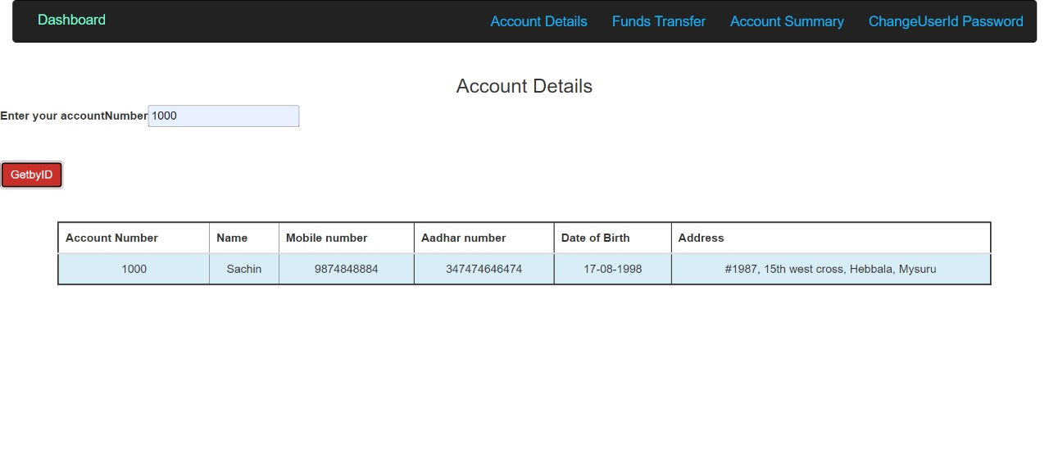
Account Details

Slide 15
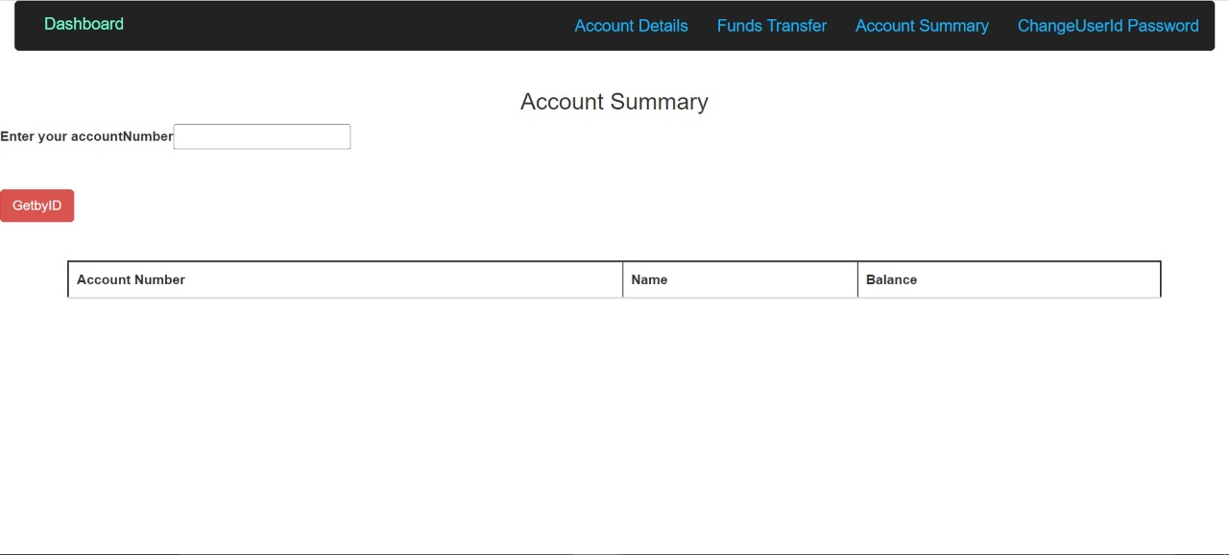
Account Summary Layout

Slide 16
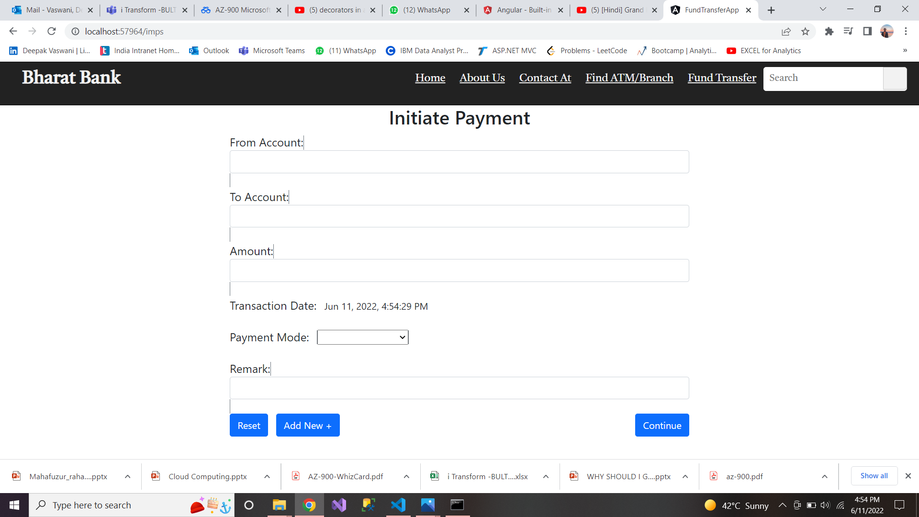
Initial Payment Page

Slide 17
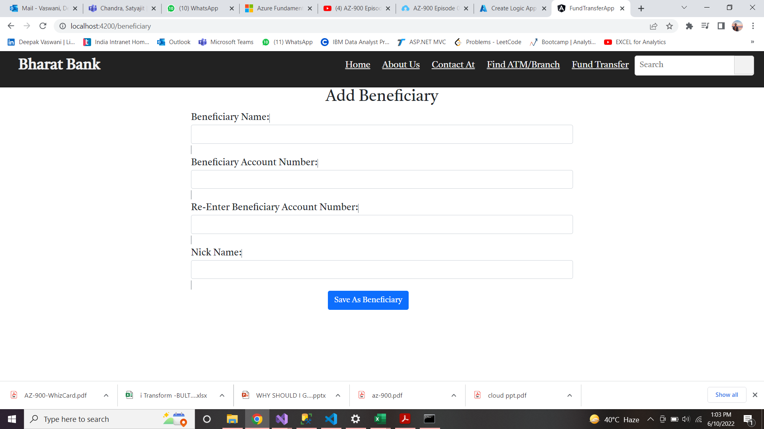
Add Beneficiary

Slide 18
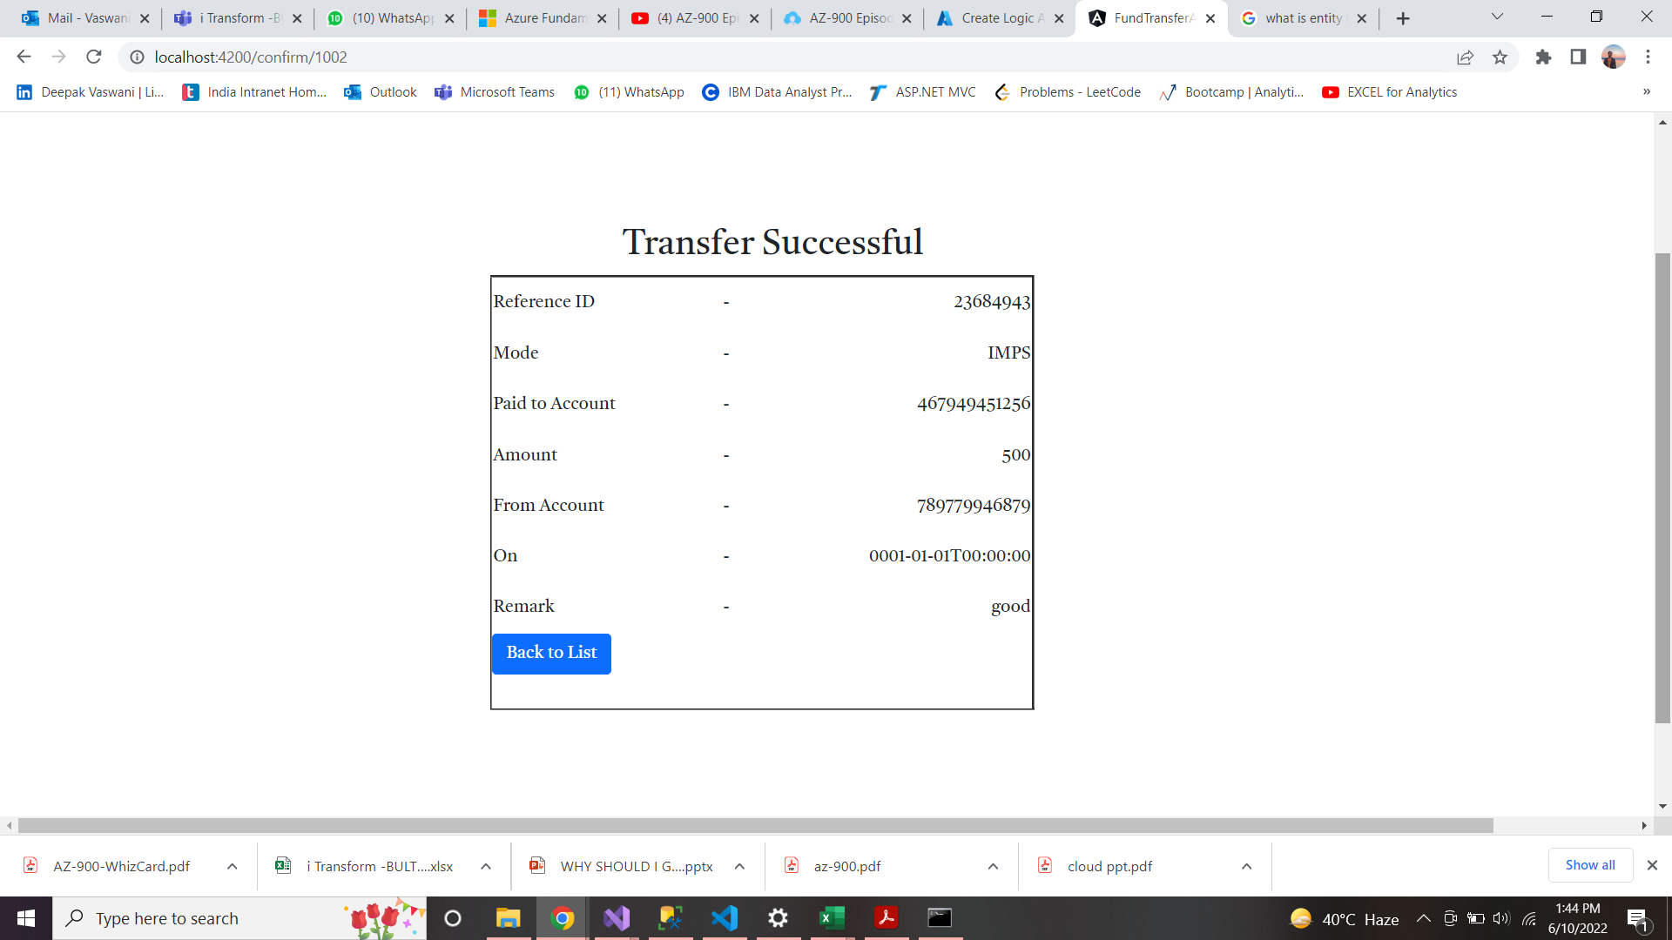
Transfer Statement

Slide 19


